Slide 1
PROJECT VIVA VOCE

Slide 2
SECURE MEDICAL TRANSCRIPTION USING BLOCKCHAIN
Gowtham Prasad S
17MSS018
Under the guidance of
Dr. J.Lekha M.Sc.,M.Phil.,Ph.D.
Associate Professor

Slide 3

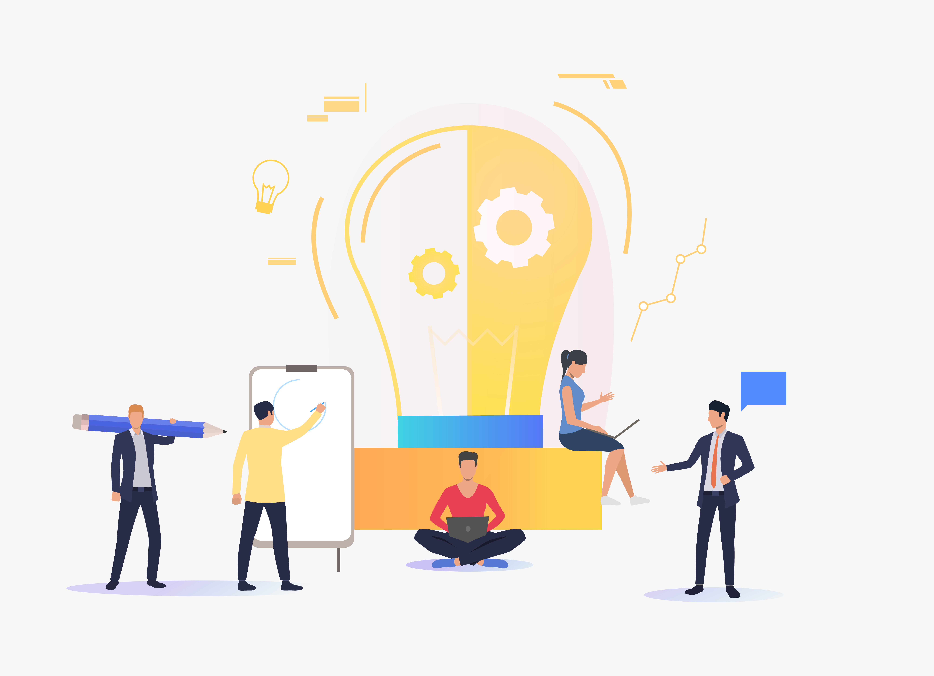
Introduction
Problem Definition
Medical data are sent to third party organization for medical transcription. Since data are passed through third party, there is a possibility of data theft. Chances of causing errors in the medical record is high. It is also expensive and time-consuming task.
Project Objective
To develop a web application to automate medical transcription through Google Speech Recognition API and to securely store the medical transcription record using Blockchain.

Slide 4
Introduction
Medical Transcription process is automated using Python and Google Speech-Recognition API. Blockchain can be used to securely store the medical records over the distributed network. These medical records will not be accessed by anyone but only by who have been granted access. The medical record can be accessed using a unique credential ID. This solution will be deployed as a web application.
It contains three primary modules:
Medical Transcription process
Storing the medical record
Accessing the medical record

Slide 5
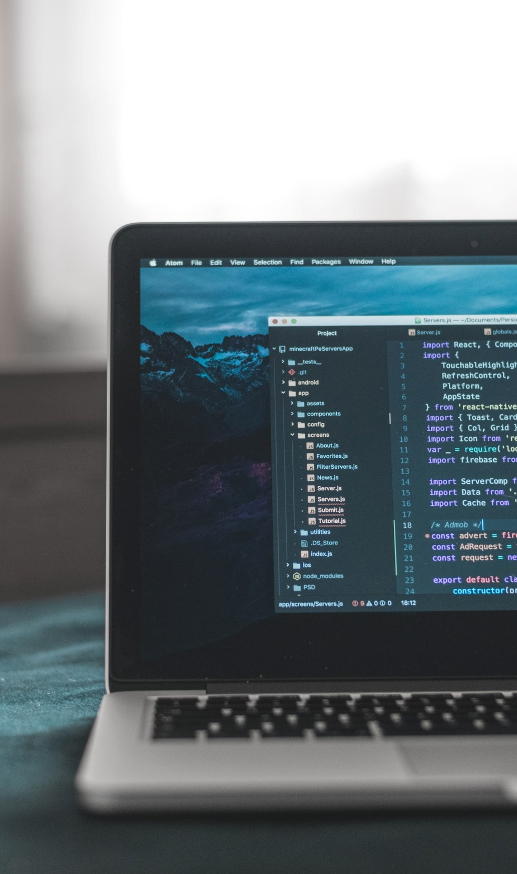
System Specification
Hardware Specification
Processor - Intel® Core™ i5-2450M CPU@2.50GHz
Installed Memory (RAM) - 4.00GB
System Type - 64-bit OS, x64-based processor
Storage - 500GB HDD
Software Specification
Operating System – Microsoft Windows 10 Pro
Editor – Microsoft Visual Studio Code

Slide 6


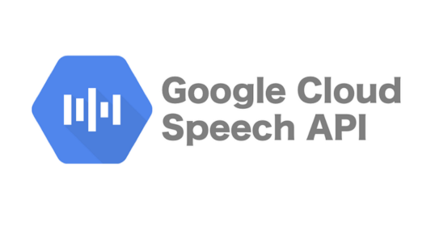

Tools, Libraries, frameworks
Meet Our Team
Python
Python is used as main programming language and it will serve as backend along with Flask.
Flask
Flask is a micro-web framework written in Python used to deploy web applications.
Speech API
Google Speech-Recognition API is used to convert audio files into text format.
HTML, CSS
HTML5, CSS3, Bootstrap are used in designing the web page.

Slide 7
System Study
Existing System with Limitations
Proposed System with Advantages
Voice reports that are sent to third party organization for medical transcription process has high risk of confidentiality breach.
Usually, it takes hours of typing to complete one medical record.
This is an expensive process and a time-consuming task.
Since Speech Recognition API is used to automate the medical transcription, time and money can be reduced.
Medical records are securely stored in Blockchain thus making it impossible for any confidentiality breach.
It will be deployed as a web application, so it makes it easy for the doctor and patient to access the medical record whenever required.

Slide 8
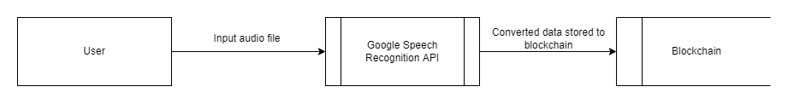
System Design – Level 0 DFD
You can simply impress your audience and add a unique zing and appeal to your Presentations. Easy to change colors, photos and Text. Get a modern PowerPoint Presentation that is beautifully designed. You can simply impress your audience and add a unique zing and appeal to your Presentations. Easy to change colors, photos and Text. Get a modern PowerPoint Presentation that is beautifully designed.

Slide 9
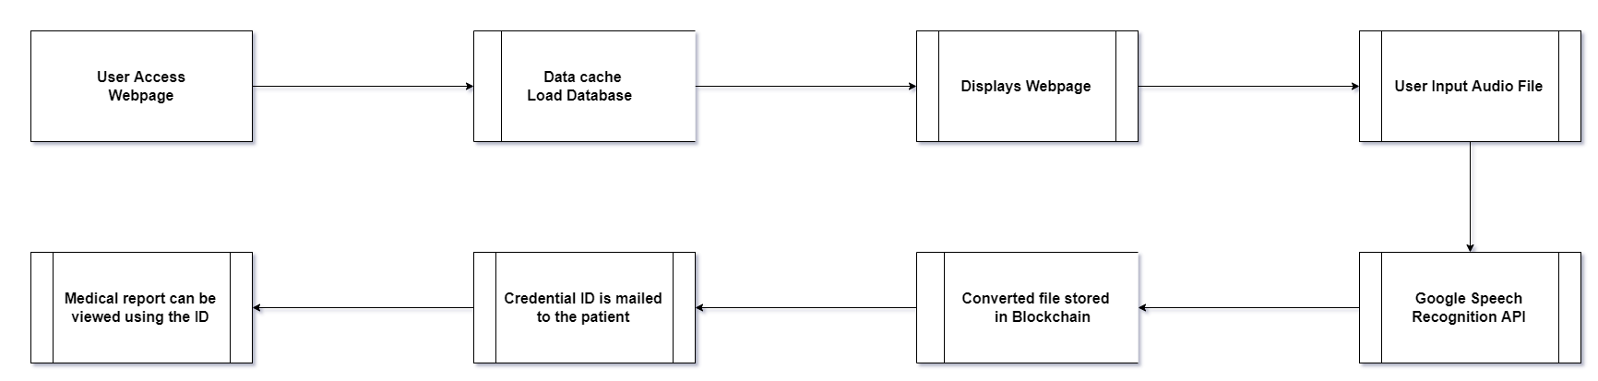
System Design – Level 1 DFD
You can simply impress your audience and add a unique zing and appeal to your Presentations. Easy to change colors, photos and Text. Get a modern PowerPoint Presentation that is beautifully designed. You can simply impress your audience and add a unique zing and appeal to your Presentations. Easy to change colors, photos and Text. Get a modern PowerPoint Presentation that is beautifully designed.

Slide 10
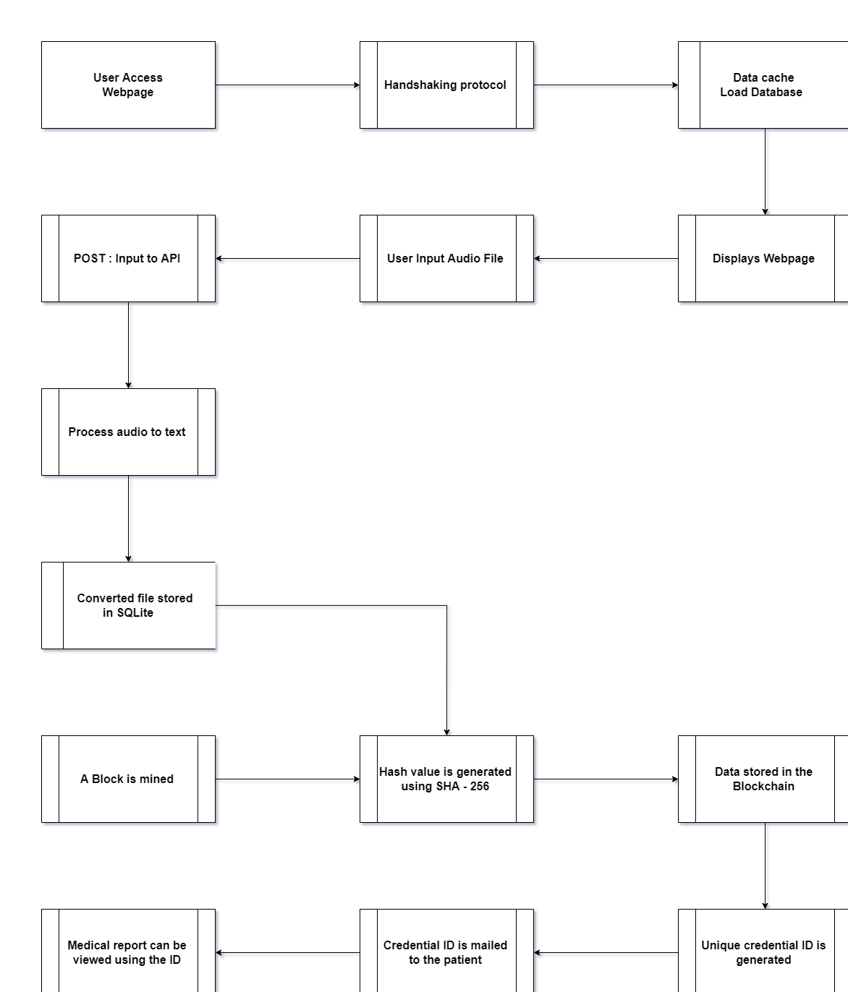
System Design – Level 2 DFD
You can simply impress your audience and add a unique zing and appeal to your Presentations. Easy to change colors, photos and Text. Get a modern PowerPoint Presentation that is beautifully designed. You can simply impress your audience and add a unique zing and appeal to your Presentations. Easy to change colors, photos and Text. Get a modern PowerPoint Presentation that is beautifully designed.

Slide 11
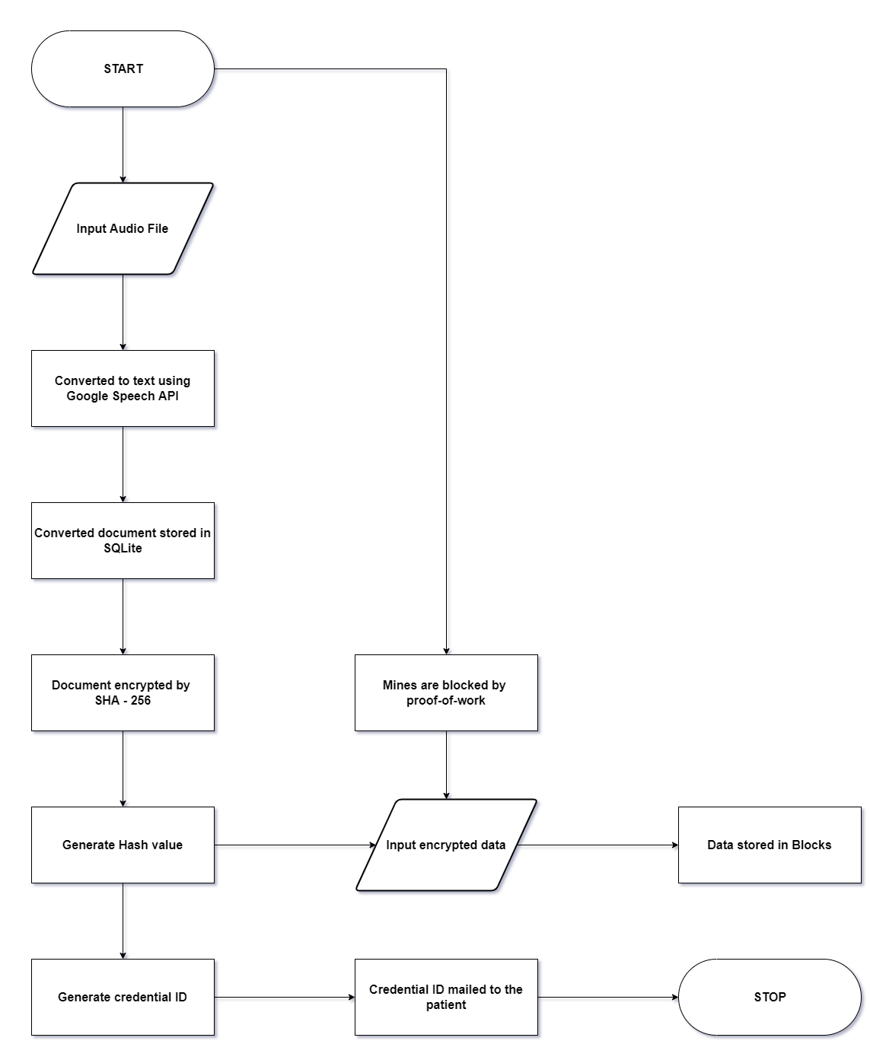
System Design – System Flow
You can simply impress your audience and add a unique zing and appeal to your Presentations. Easy to change colors, photos and Text. Get a modern PowerPoint Presentation that is beautifully designed. You can simply impress your audience and add a unique zing and appeal to your Presentations. Easy to change colors, photos and Text. Get a modern PowerPoint Presentation that is beautifully designed.

Slide 12
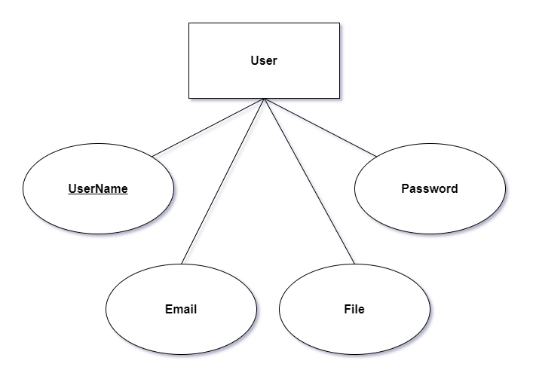
System Design – ERD
You can simply impress your audience and add a unique zing and appeal to your Presentations. Easy to change colors, photos and Text. Get a modern PowerPoint Presentation that is beautifully designed. You can simply impress your audience and add a unique zing and appeal to your Presentations. Easy to change colors, photos and Text. Get a modern PowerPoint Presentation that is beautifully designed.

Slide 13
System Testing
01
02
03
04
Unit Testing
Integration Testing
Functional Testing
System Testing
Unit testing focuses first on the modules, independently of one another, to locate errors. 3 Modules are tested individually and no errors are found.
Integration testing is done by combining multiple modules and tested against a test harness. Here conversion of audio file and blockchain storage are tested together.
Different types of inputs are given and tested. Different audio samples, details are given and tested accordingly.
System testing is done to the fully completed deployed web application. It is found that, the web application and its modules are working perfectly.

Slide 14
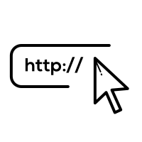

System Implementation
Maintenance
Implementation is the stage of the project where the theoretical design is turned into a working system.
The web application is developed and deployed using Flask web framework .
Doctor(User) has to enter patient details and upload audio file.
To access the medical report, patient details with password is provided.
The web application is maintained on a regular basis.
Navigation links and load speed are checked regularly.
Web pages are checked for 404 errors and SEO, meta titles are reviewed.
Speech API is updated frequently to provide best result to the user.
And security checks are done regularly.

Slide 15
Conclusion
Medical transcribers deal with sensitive health information and they have specific obligations that are often protected by the law. Breachers in medical records can refer to a wide range of security issues that endanger a patient’s confidentiality and trust in an organization. Many medical transcription companies offer tiered payments to complete the work faster, ignoring the quality that rushes reports may produce. So, these issues gave rise to the idea of usage of Blockchain. Medical Transcription process makes use of Google Speech-Recognition API which automates the process by converting audio files into text. Then the file is stored in the Blockchain.
This solution is developed as web application where the user uploads the audio file and it is converted into text format and stored in Blockchain. A unique credential ID is generated and mailed to the patient. Using that the medical report can be accessed.

Slide 16

Future Enhancements
Process for converting audio files to text will be further improved to identify two-person conversation into text.
Process for converting audio files to text will be further improved to convert large audio files within minimum amount of time.
More cryptographic techniques will be probed to incorporate in Blockchain to make it even more secure.

Slide 17
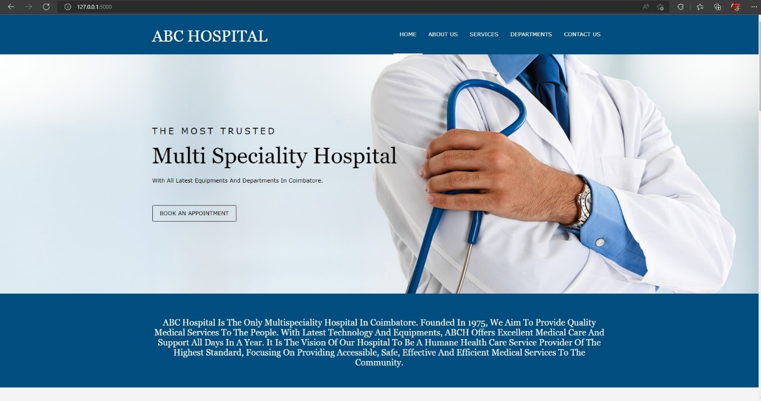
Sample Screenshots
You can simply impress your audience and add a unique zing and appeal to your Presentations. Easy to change colors, photos and Text. Get a modern PowerPoint Presentation that is beautifully designed. You can simply impress your audience and add a unique zing and appeal to your Presentations. Easy to change colors, photos and Text. Get a modern PowerPoint Presentation that is beautifully designed.

Slide 18
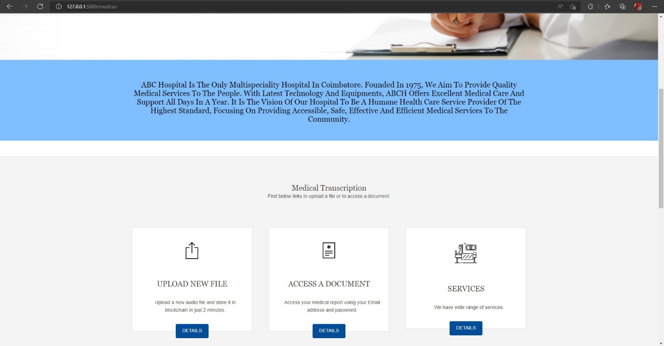
Sample Screenshots
You can simply impress your audience and add a unique zing and appeal to your Presentations. Easy to change colors, photos and Text. Get a modern PowerPoint Presentation that is beautifully designed. You can simply impress your audience and add a unique zing and appeal to your Presentations. Easy to change colors, photos and Text. Get a modern PowerPoint Presentation that is beautifully designed.

Slide 19
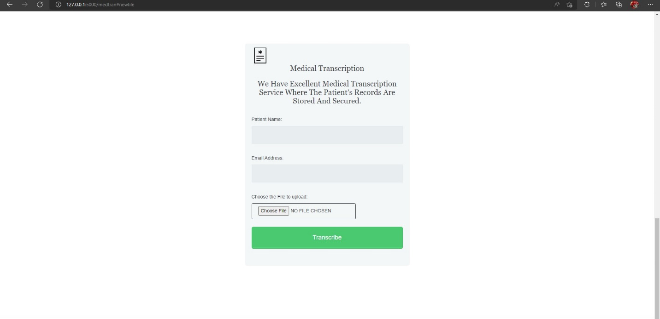
Sample Screenshots
You can simply impress your audience and add a unique zing and appeal to your Presentations. Easy to change colors, photos and Text. Get a modern PowerPoint Presentation that is beautifully designed. You can simply impress your audience and add a unique zing and appeal to your Presentations. Easy to change colors, photos and Text. Get a modern PowerPoint Presentation that is beautifully designed.

Slide 20
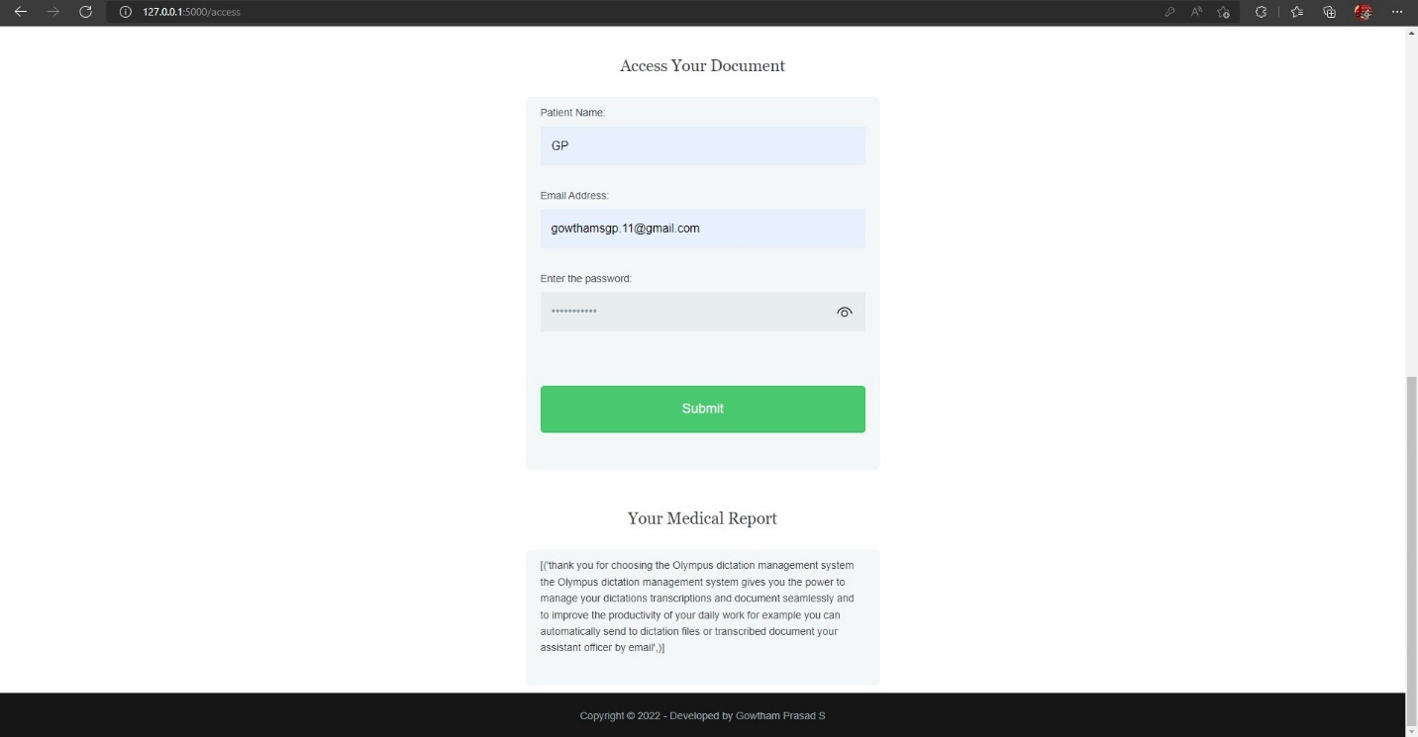
Sample Screenshots
You can simply impress your audience and add a unique zing and appeal to your Presentations. Easy to change colors, photos and Text. Get a modern PowerPoint Presentation that is beautifully designed. You can simply impress your audience and add a unique zing and appeal to your Presentations. Easy to change colors, photos and Text. Get a modern PowerPoint Presentation that is beautifully designed.

Slide 21
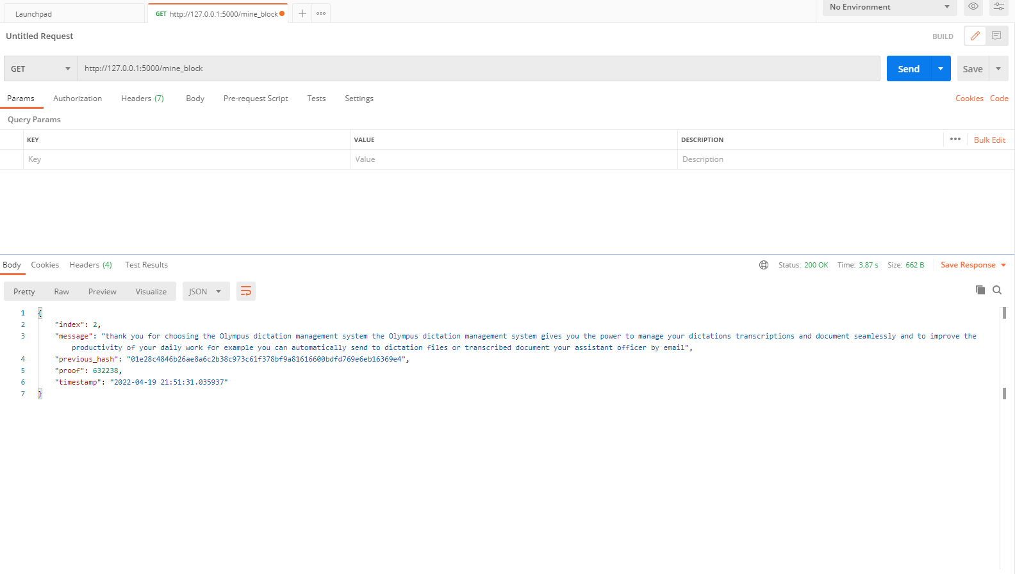
Sample Screenshots
You can simply impress your audience and add a unique zing and appeal to your Presentations. Easy to change colors, photos and Text. Get a modern PowerPoint Presentation that is beautifully designed. You can simply impress your audience and add a unique zing and appeal to your Presentations. Easy to change colors, photos and Text. Get a modern PowerPoint Presentation that is beautifully designed.

Slide 22
Thank You!

